Slide 1
AIM TSC
DPM Ad Hoc
A Revised Quality Measurement Method for DPM
Presentation to MH10.8
7 April 2006

Slide 2
Agenda
Background: what are the problems with ISO15415 & AS9132
AIM DPM Quality Guideline Summary
Realities of DPM that Application Standards must consider when writing a standard
Recommendations for Application Standards

Slide 3
Background: the problem
Good DPM marks are getting failing grades under today’s ISO/IEC 15415 and AS9132 method
  “Good” as determined by visual inspection and reader performance
Typical failure modes:
  Symbol Contrast
  Print growth
  Unconnected Dots in the ‘L’
  Sub-optimal illumination

Slide 4
Background: the problem
ISO 15415 Issues
  DPM parts not properly imaged
  Poorly defined method to threshold image
  Does not decode dot codes
  Requires “5 scans” to grade
  Lighting not appropriate for DPM
Result
  Good marks fail due to no decodes, low contrast, poor modulation &/or Fixed Pattern Damage
AS9132 Issues
  No defined implementation method
  Tolerances too tight for laser etch
  Does not check critical aspect of the mark
    Ex: Decode, quiet zone, error correction, etc.
Result
  Inconsistent results from vendor to vendor
  Good marks fail due cell size
  Bad marks can get passing grades

Slide 5
AIM DPM Summary
  Marking method independent
  Incorporates necessary lighting options to address all material and surface characteristics
  Provides very good correlation between the quality of mark and readability from commercial off the shelf DPM readers
  Specialty readers and verification solutions will be needed for a small percentage of parts due to part characteristics

Slide 6
Summary of AIM DPM
What did we do?
Necessary lighting options including: 30 degree low angle, 30 degree low angle directional, diffuse on-axis and diffuse off-axis
Processes different from ISO 15415
A different method for setting the image contrast
A different method for creating the binary image.
A new method for choosing the aperture size.
An image pre-process methodology for joining disconnected modules in a symbol.
A different process for determining the Modulation parameter renamed Cell Modulation.
A different process for determining the Symbol Contrast parameter which has been renamed Cell Contrast.
A difference process for computing Fixed Pattern Damage
A new parameter called Minimum Reflectance.

Slide 7
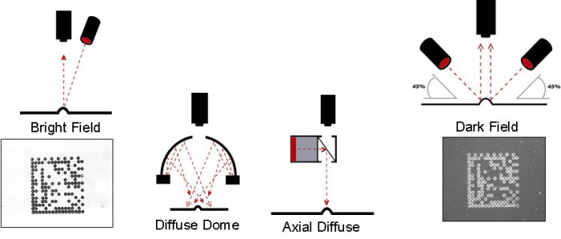
Summary of AIM DPM
What did we do?
Adopted the appropriate illumination techniques for DPM
  Low angle lighting (30Q = all 4 sides, 30T = 2 sides)
  Diffuse on axis lighting (90)degrees)
  Diffuse off axis lighting (D)

Slide 8
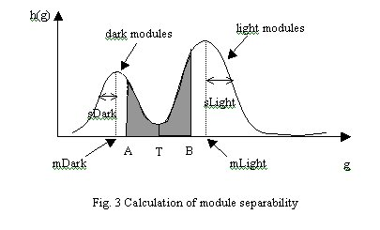

Summary of AIM DPM
What did we do?
Applied a different method for creating the binary image

Slide 9
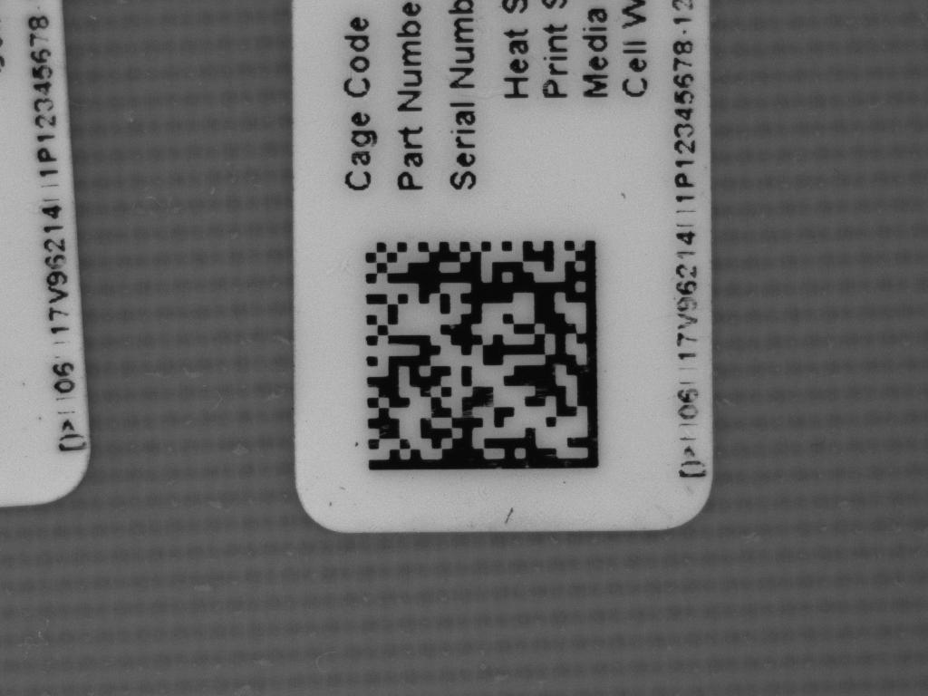
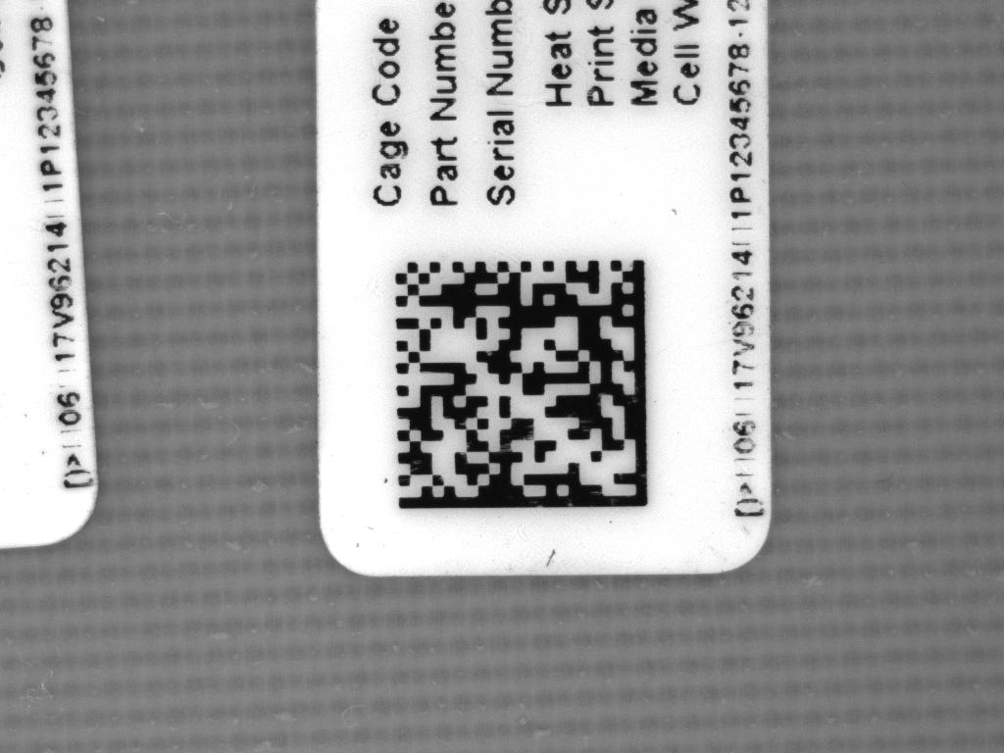
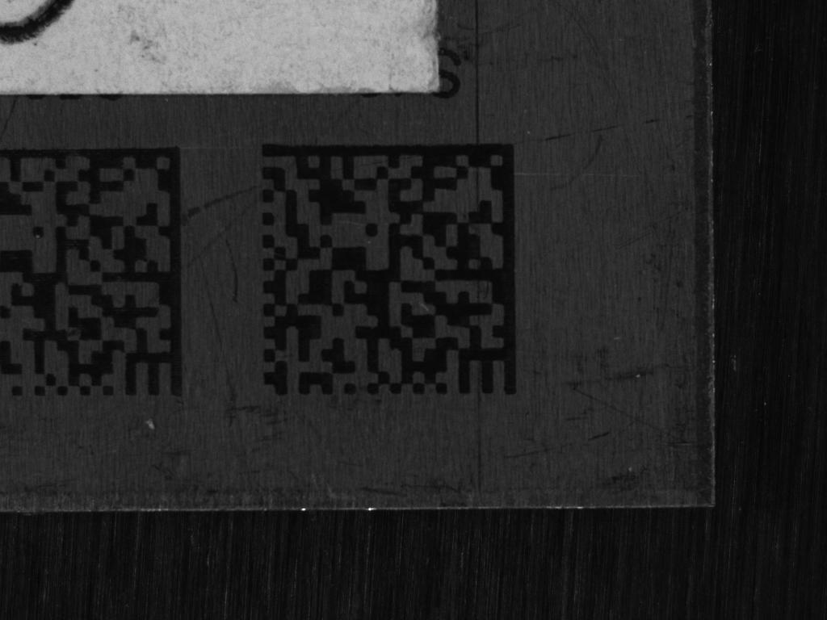
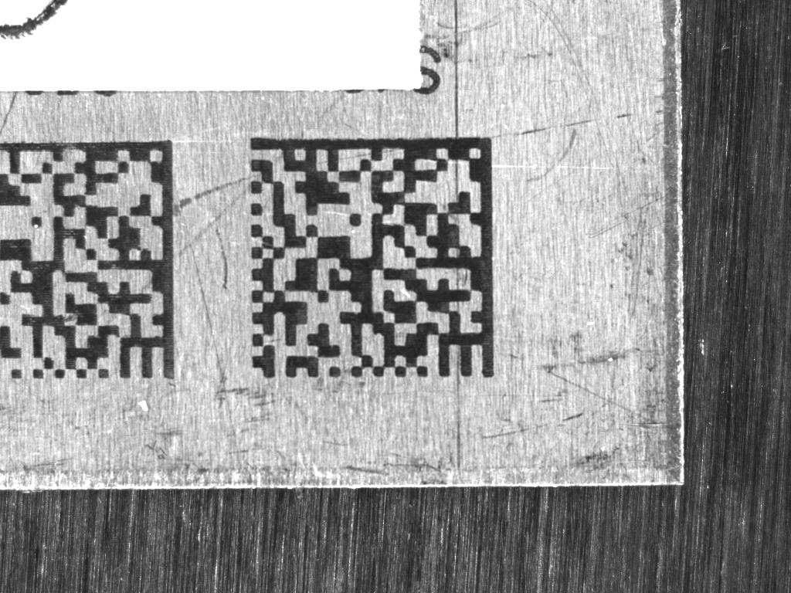
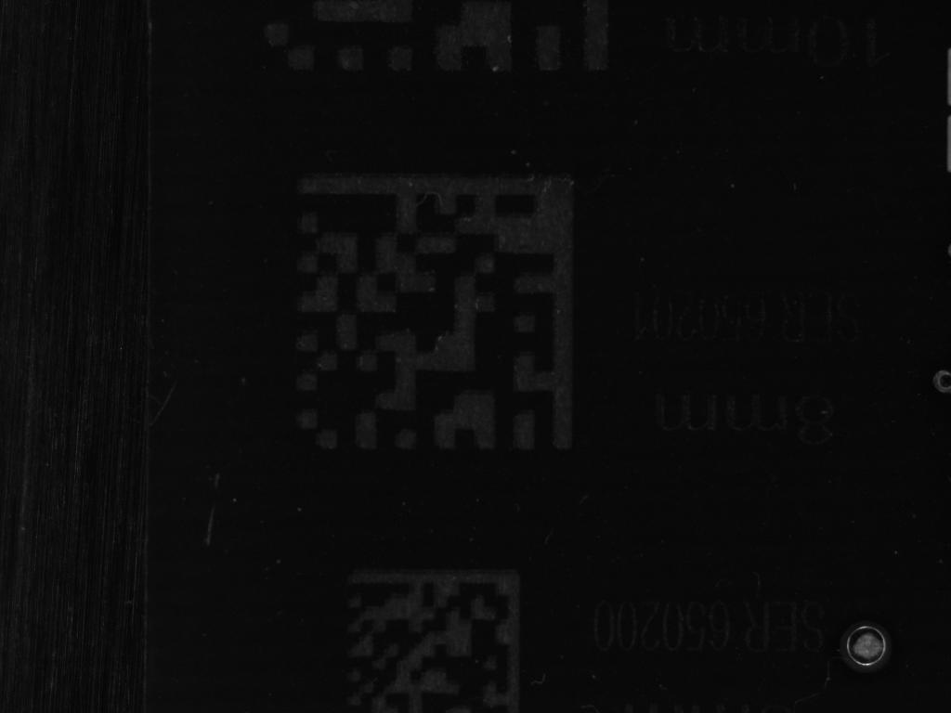
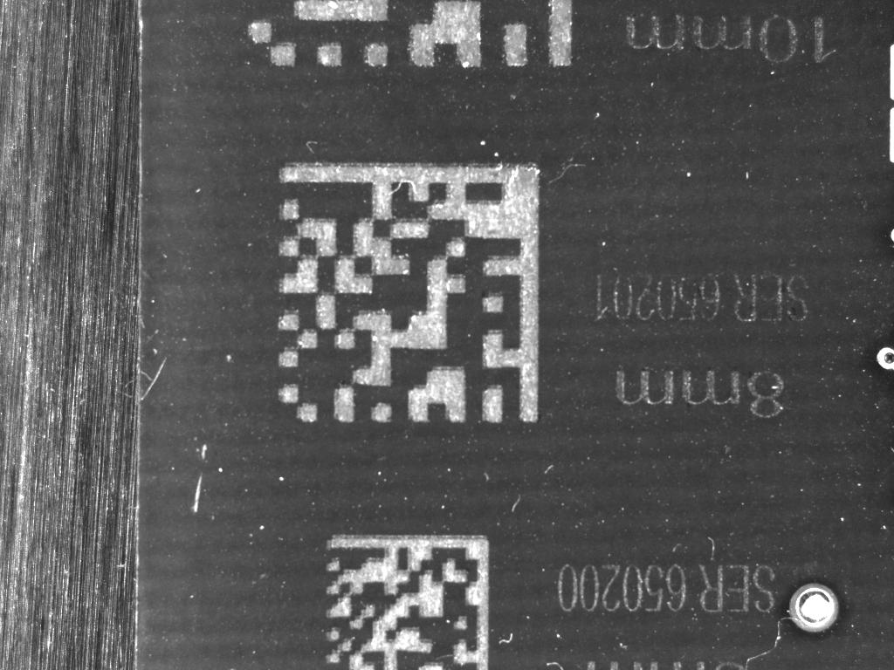
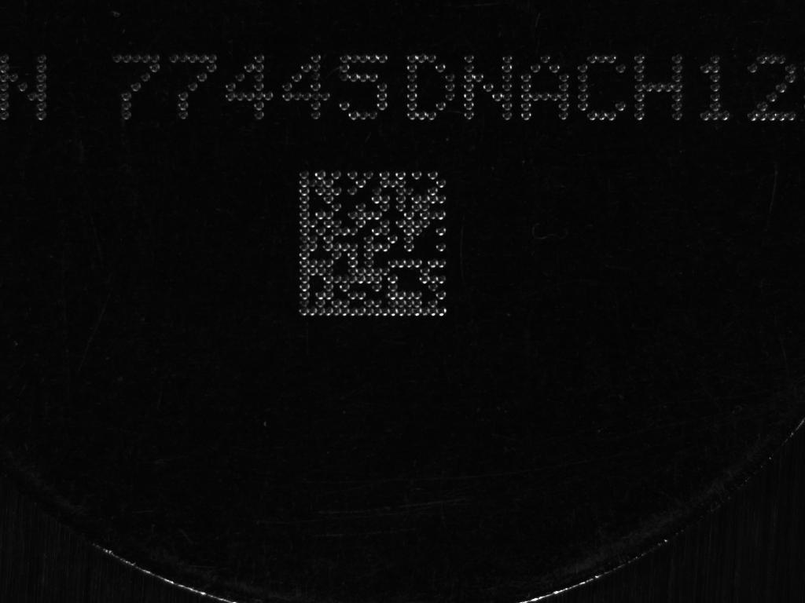
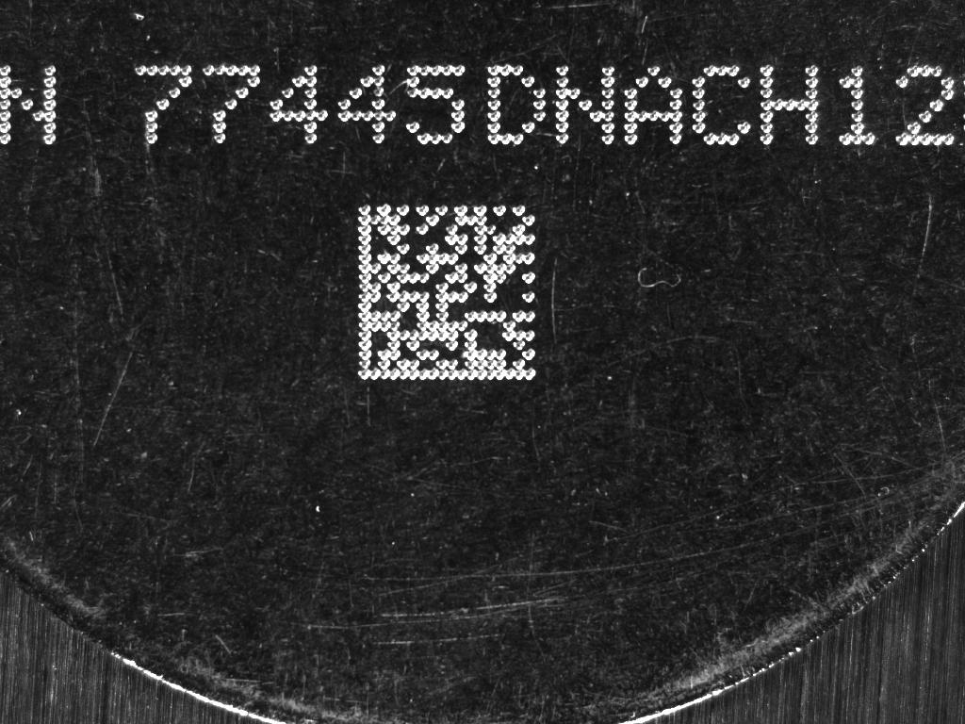
Summary of AIM DPM
What did we do?
Applied a different method for setting the image contrast
  Image on left is ISO 15415 method and image on right is AIM DPM method

Slide 10
DPM Grading
Nomenclature
There are changes in the format of the reported grade
Application specs can now specify:
  Combinations of allowed lighting
  Allowable X dimensions
Example: DPM3.0/5-20/640/(30|90)/(V|H)
  Allows lighting at 30 or 90 degrees
  Lighting can be from N/S or E/W
Other options supported, such as ‘Q’ for lighting from all four sides

Slide 11
Application
Group Decisions
Consider Different Mark & Reading Situations
What are the range of X dimensions
What is the minimum acceptable grade level?
  Category 0: Paper only
  Category 1: Flat DPM parts
  Category 2: Flat DPM parts + round parts
  Category 3: Specialty Parts Require specialized reading solutions
  Cat 0: Any 2D Reader
  Cat 1: Any DPM Reader
  Cat 2: DPM Readers that provide “D” lighting
  Cat 3: Proprietary / customer reading solution

Slide 12
Recommendations
All Marking Methods
  Minimum Grade: 1.0
  Minimum X dimension: no change
  Lighting: /(30|90|D)/(Q|V|H)
    Allows all lighting option
    30 degree lighting can be from all sides, N/S or E/W
Specialty Parts where COTS Readers Don’t Apply
  Use specialty reading equipment with proprietary decode, Unused Error Correction, Grid Non Uniformity, Axial Uniformity or AS9132

Slide 13
Conclusions
The DPM verification technology issues have been addressed
Applications standards need to reference AIM DPM guideline and choose appropriate categories
Draft of an AIM spec on DPM quality is ready for public review

Slide 14
AIM TSC
DPM Ad Hoc
A Revised Quality Measurement Method for DPM
Presentation to MH10.8
26 May 2005

